Slide 1
Using Natural Language Processing to Analyse the Shape of Stories
29th May 2020
Luca Davies – B.Sc. (Hons.) Computer Science
Notes:
Good morning, I hope you’re both fairing well…

Slide 2

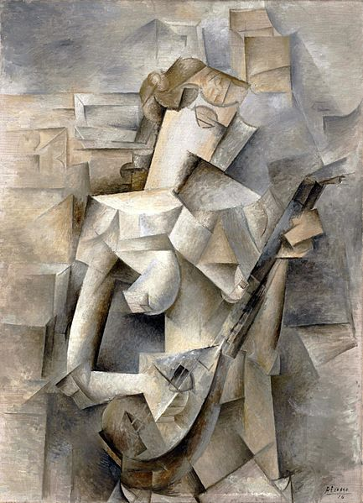
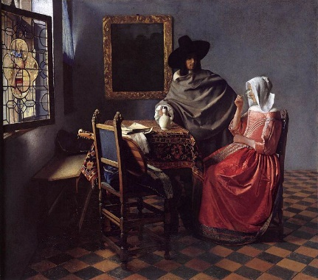
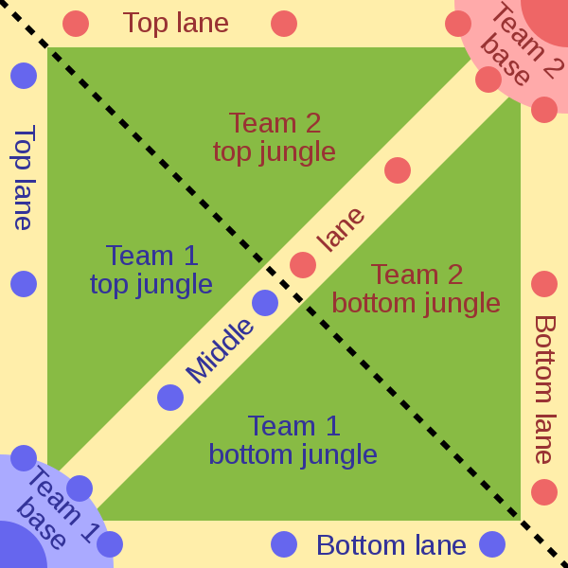
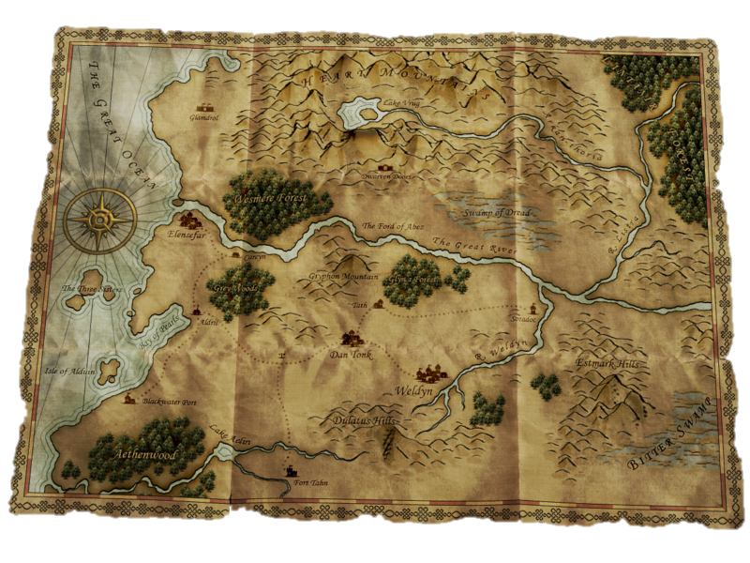
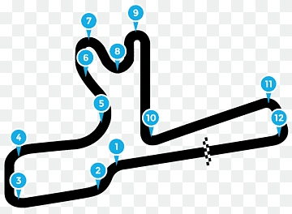
Why?
Story graphs from openculture.com article modified to show only the graphs
Map of MOBA by Raizin and Sameboat, is licensed under Creative Commons Attribution-Share Alike 3.0 Unported
Battle for wesnoth httt world map by David White and others is licensed under GNU GPL
Map, Race Track, Location is free for editorial, personal or academic use
Patterns exist in all forms of media
Art movements, genres of film, book, music, video game
All of these have patterns
Sometimes the “template” used is more obvious than others…
Notes:
Stemming from Vonnegut’s own proposed Master’s thesis
Patterns everywhere, art, music, film & television… literature very free medium, patterns here too?
Procedural gen. in games, all over worlds, “quests” etc, short stories -> longer stories -> novels?
Partly: why not?
Novel idea (punny), Vonnegut’s thesis rejected by Uni. of Chicago due to it being ”too much like fun”
Insight into consistency in literature (or lack of)
In pursuit of this, I built the Sentiplot program to process corpora and produce graphs for analysis

Slide 3
How? Input Text Pre-processing
See Sec. 3
Input media types require different handling
TXT
Plain text – additional white space and line breaks removed
XML
XML – VARDed corpora only, tags and extraneous non-text data removed
HTML
HTML – Project Gutenberg format, split into chapters where possible based on HTML header tags, then move extraneous, non-text data
Pre-processing
Sentence splitting
Analysis
Post-processing
Plotting
Notes:
High level pipeline shown at the bottom
Three different input types
All require different parsing and afford different features
Plain text, least metadata
XML/VARD, spelling normalised, per-character information (per-character graphing)
HTML/Proj. Gutenberg format permits splitting on chapters… sometimes

Slide 4
How? Natural Language Processing Methods
See Sec. 3
Stanford CoreNLP
Sentence splitting (via “Simple API”)
Single function call
VADERSharp
Processing of whole sentences
Outputting scores per sentence
Pre-processing
Sentence splitting
Analysis
Post-processing
Plotting
Notes:
Stanford CORENLP used to split input into sentences
VADERSharp (C# port of VADER) used to process each sentence and output sentiment metrics

Slide 5
How? Collecting VADER’s output in a useful way
See Sec. 3
Collecting the list of analysis results in individual chapters and the whole text
Generate a new ResultsViewer form and pass the collections through to be plotted
Pre-processing
Sentence splitting
Analysis
Post-processing
Plotting
Notes:
Results are grouped together, keeping apart each section which will be graphed individually

Slide 6
How? Plotting the data for presentation
See Sec. 3
ResultsViewer is passed n result sets
Each contains four result types (combined, positive, negative, neutral), all plotted on whole-text graph, combined only plotted per chapter
Data points are plotted by averaging m values on the sentiment (y) axis and using the final value on the time-progression axis (x)
m is the number of sentences equating to the percentage of the text selected by the granularity slider
Pre-processing
Sentence splitting
Analysis
Post-processing
Plotting
Notes:
Absolute data in hand, display of that is the final step
Granularity slider comes in here: MANY SENTENCES setting the size of the block of sentences that are averaged
Retrospecitvely, a rolling average of the width of the block size may have worked better to show trend with more clarity

Slide 7
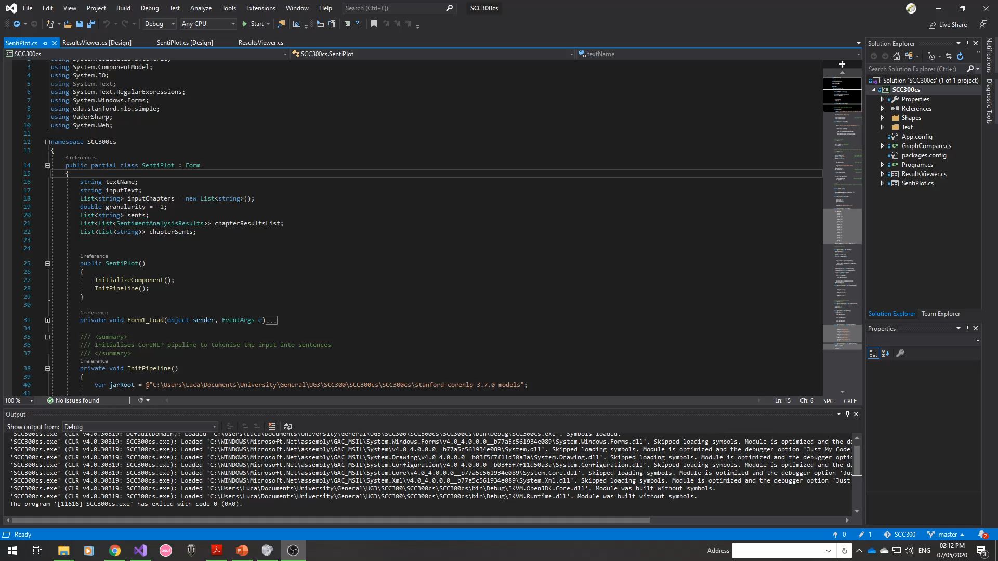
The Sentiplot Tool
Notes:
Live demo use of Sentiplot tool (failing live, video is present)
WinForms app
Select a text
Show pre-processed input
Move Granularity slider to ~0.2-2%
Process…
Point out vague shape
Show different line options (only one used greatly)
Show table and contents
Show chapter graphs (and possibility of subcurves)
Show different granularity extreme

Slide 8
Data & Experiment Selection
See Sec. 4/5
Texts chosen directly influenced by:
Vonnegut’s examples
My personal literary knowledge
Experiments chosen by:
Vonnegut’s rejected thesis (is there a shape at all?)
Logical further steps arising from previous experiments
Notes:
Results not quite as expected: are the tools working right (hence: hand analysis, hence reader analysis)

Slide 9
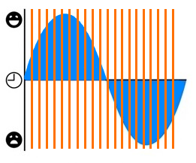
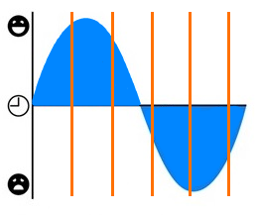
Data & Experiment Selection
See Sec. 5
Analysis Block Size pg. 17
Curve Identification (Whole text / per chapter) pg. 19
Hand Analysis vs. VADER pg. 20
Reader Analysis & Reflection pg. 22
Early Modern Vs. Modern English pg. 24
Story graphs from openculture.com article modified to show only a single graph, blank with added lines
Notes:
Exp rationale.
Block size: naturally derived from knowledge of data sampling and the potential differences
Curve identification: the crux of the original proposal (application to both full text and chapters is novel)
^^^ “Original” experiments ^^^
Hand analysis: ensure tools actually work
Reader Analysis & Reflection: do readers perceive there to be curves in texts
^^^ Unexpected results early on, check things working as expected ^^^
Do the tools perform well/better in ModE or EModE
^^^ exploration with available corpora ^^^

Slide 10
Experimentation in a nutshell: Early Modern vs. Modern English
See Sec. 5.5
This experiment focused exclusively processing Shakespearean plays:
With original early-modern English
With spelling-normalised, modern English (as produced via VARD)
Results: Similar pattern, but visibly exaggerated, even some new features entirely. Proof, less that this is better for VADER, more that EModE is poorly recognised by comparison
Conclusion: When attempting to perform sentiment analysis on EModE texts, results may be significantly easier to analyse if the text is first subject to spelling normalisation.

Slide 11
Limitations
Range of corpora
Relatively narrow range of texts examined
Small number of texts
Ability of NLP tools
Other tools may exist that are better suited to the analysis carried out
Inference vs. Statistical Methods
Identification of curves could be implemented mathematically
Notes:
Range small: to keep good experimental control over the experiments carried out and to keep within the time limit
Whole project could be repeated with any number of different NLP tools and potentially yield results, could be done with more time
Curve identification – time limits, again

Slide 12
Questions…
29th May 2020
Luca Davies – B.Sc. (Hons.) Computer Science

